Slide 1

SUPPLY CHAIN

Slide 2
Retail Stores Inventory and Demand
The Final Project for Top Analyst Team
Fatmaelzahraa Ali Khamiss Ahmed
Heba Mohamed El sherif Mohamed
Bola Ghandour Ramzi Hikam
Gerges Qadis Moniur Escarous
Mariam Khaled Khalil Khalila
Leader
Member
Member
Member
Member

Slide 3

Project Overview
This project analyzes “Retail Stores Inventory and Demand” from 2022 to 2024 in terms of observing consumer behavior, pricing strategies and product availability across the year. It includes prices of various categories, offering insights into price trends, consumer behavior and an epidemic feature to simulate retail conditions during COVID-19 pandemic period enhancing the realism and practical value of the data.

Slide 4

Business Overview
The analysis reveals a concerning gap between 45 million units ordered and 21 million units actually sold. The North region is the strongest performer in both sales and inventory turnover. Promotional offers show a positive effect (0.26 Uplift), but attention must be paid to the finding that customer ratings are not correlated with the financial value of their purchases, highlighting the importance of the service experience.

Slide 5
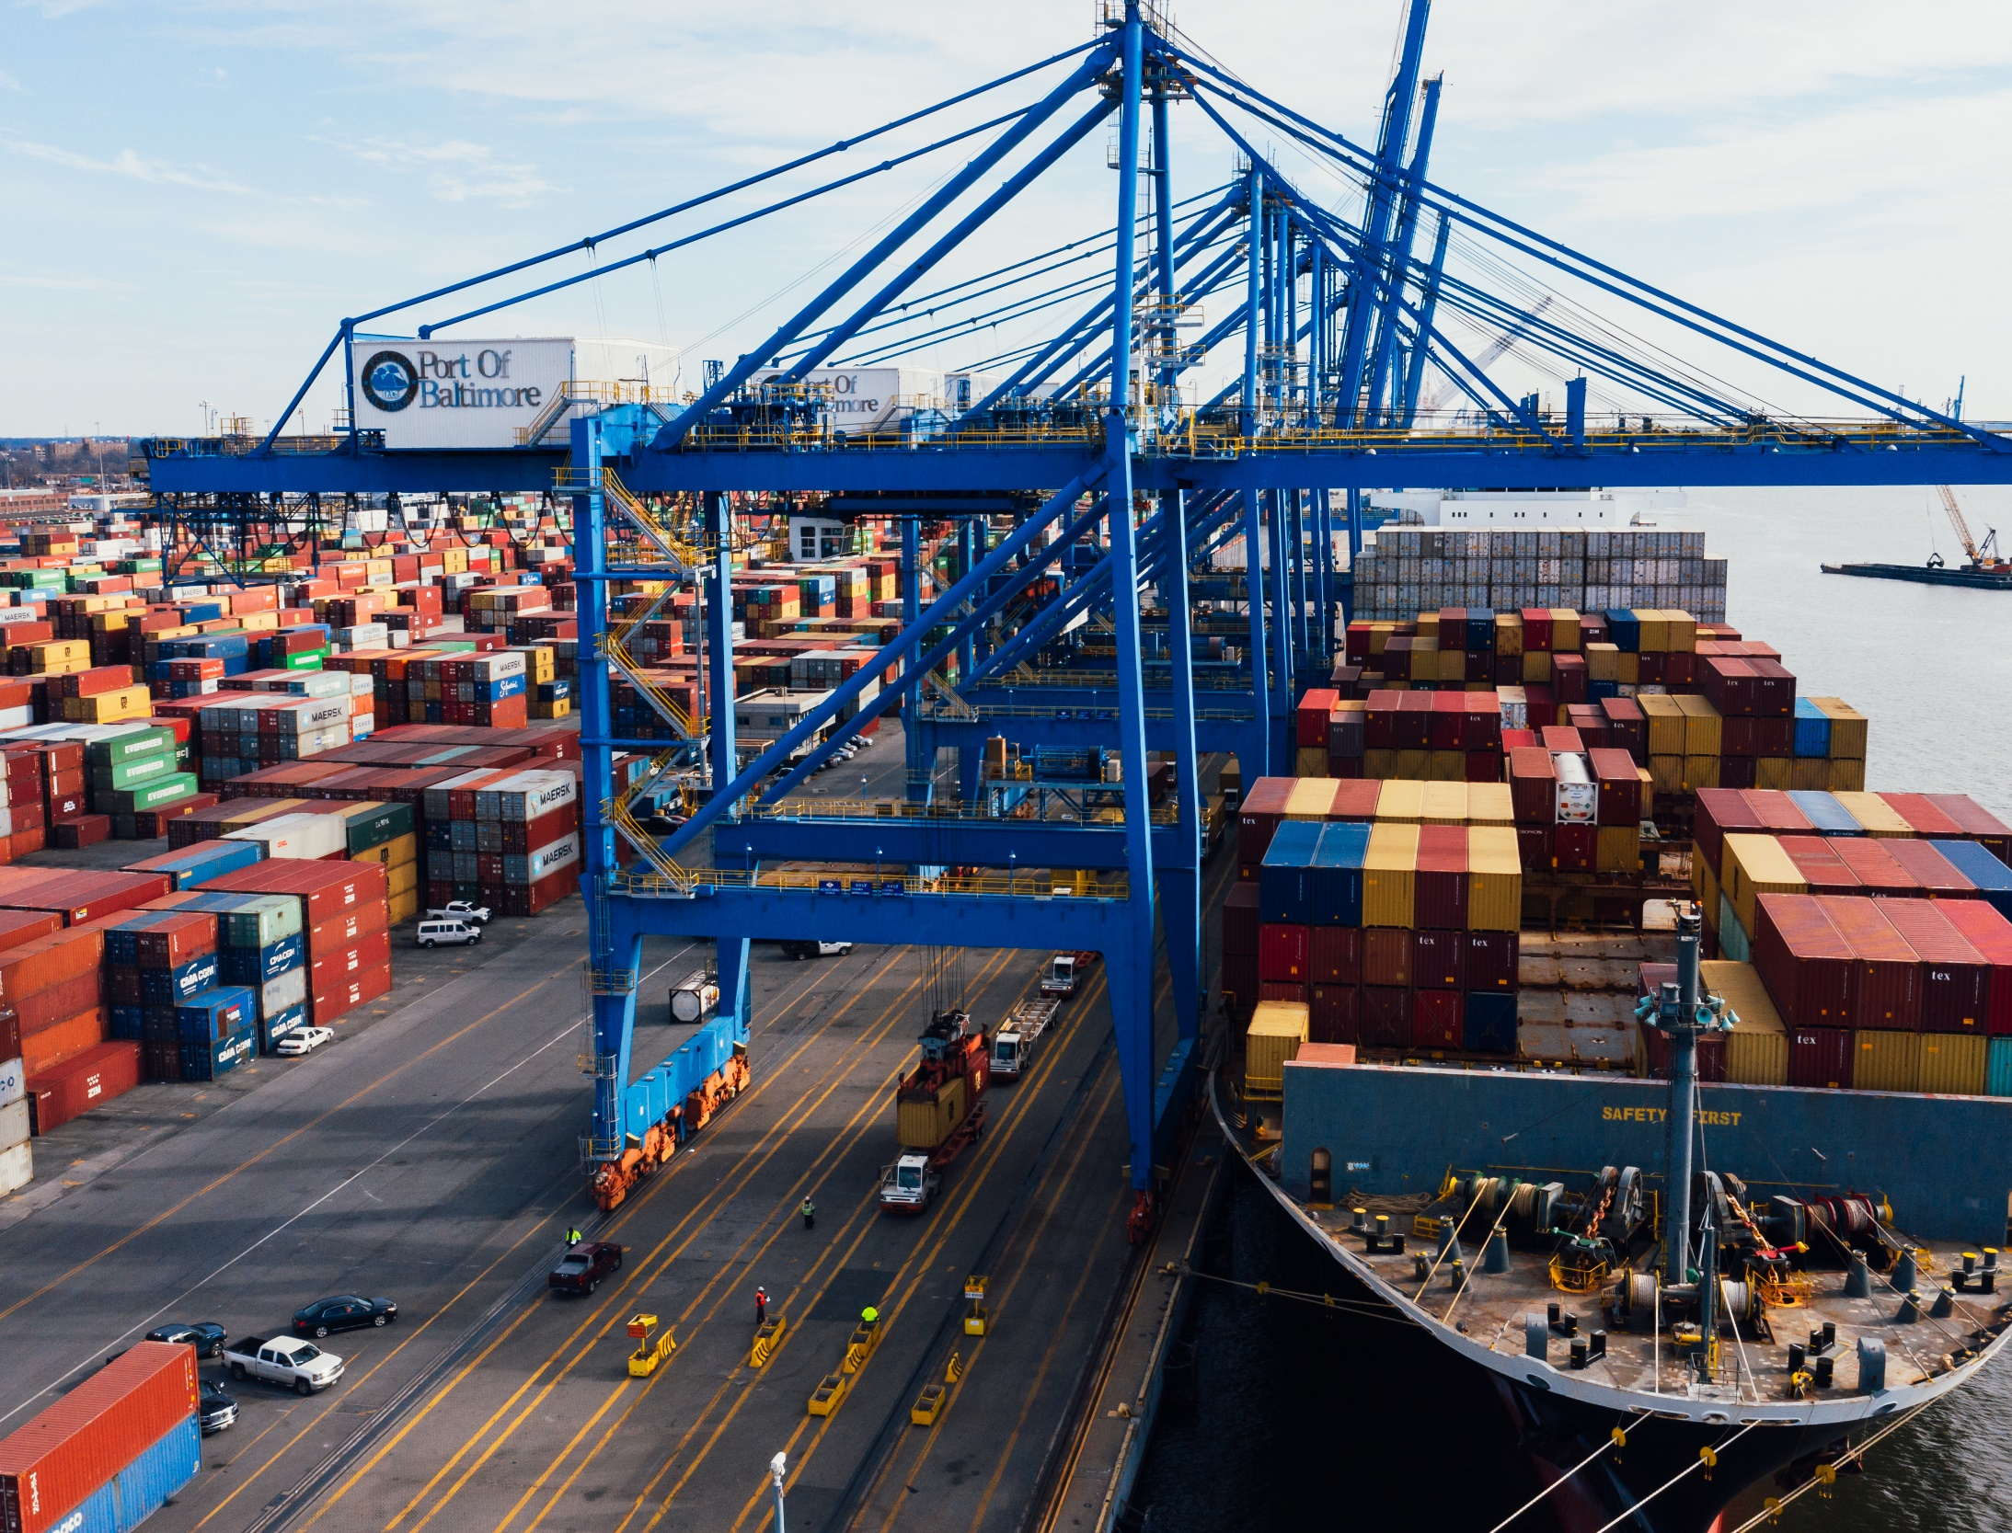
Project
KPIs
1.
Order to Sales Conversion Rate
2.
Discount-Adjusted Profit Margin
3.
Crisis Resilience
4.
Regional Sales Contribution Balance
5.
Customer Experience Quality

Slide 6
Project Problems
Only 21 million units were sold compared to 45 million units ordered, indicating a severe fulfillment or forecasting issue.
The North region dominates sales and inventory turnover, while the South region registers the lowest turnover rate.
Customer ratings are not correlated with the financial value of their purchases, highlighting the importance of the service experience.
The average sales drop during the pandemic was a severe 60.16%, highlighting a major failure in sales channel resilience.
The business experiences a sharp, across-the-board sales decline in January following holidays, along with historically weak performance in months like April and May.

Slide 7

1. Only 21 million units were sold compared to 45 million units ordered, indicating a severe fulfillment or forecasting issue.
The organization must urgently investigate and resolve the massive discrepancy between ordered and sold units. This requires an immediate Gap Analysis to determine the cause (e.g., inventory shortages, cancellations, stockouts, poor forecasting, or recording errors) and implement measures to align future purchase orders more accurately with actual sales figures.

Slide 8
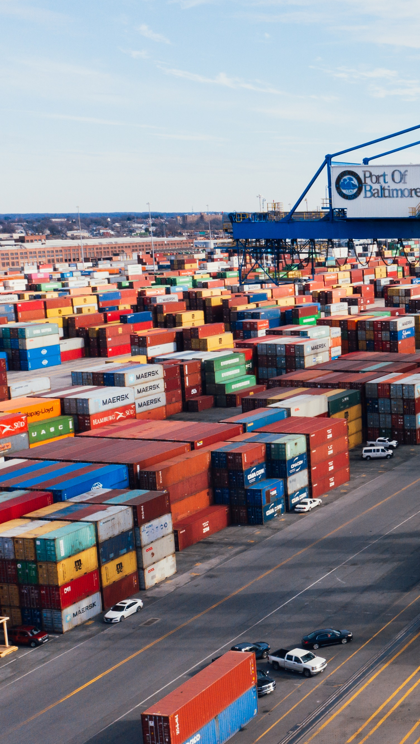
2. The North region dominates sales and inventory turnover, while the South region registers the lowest turnover rate.
Allocate increased marketing and promotional resources to the lower-performing regions, especially the East region, to boost their sales contribution and reduce over-reliance on the North region's performance.

Slide 9

3. Customer ratings are not correlated with the financial value of their purchases, highlighting the importance of the service experience.
The business must shift its focus from transaction size to service quality. Since service and experience drive satisfaction, the solution is to invest in excellent customer service and post-sale experience to drive positive ratings and foster customer loyalty.

Slide 10
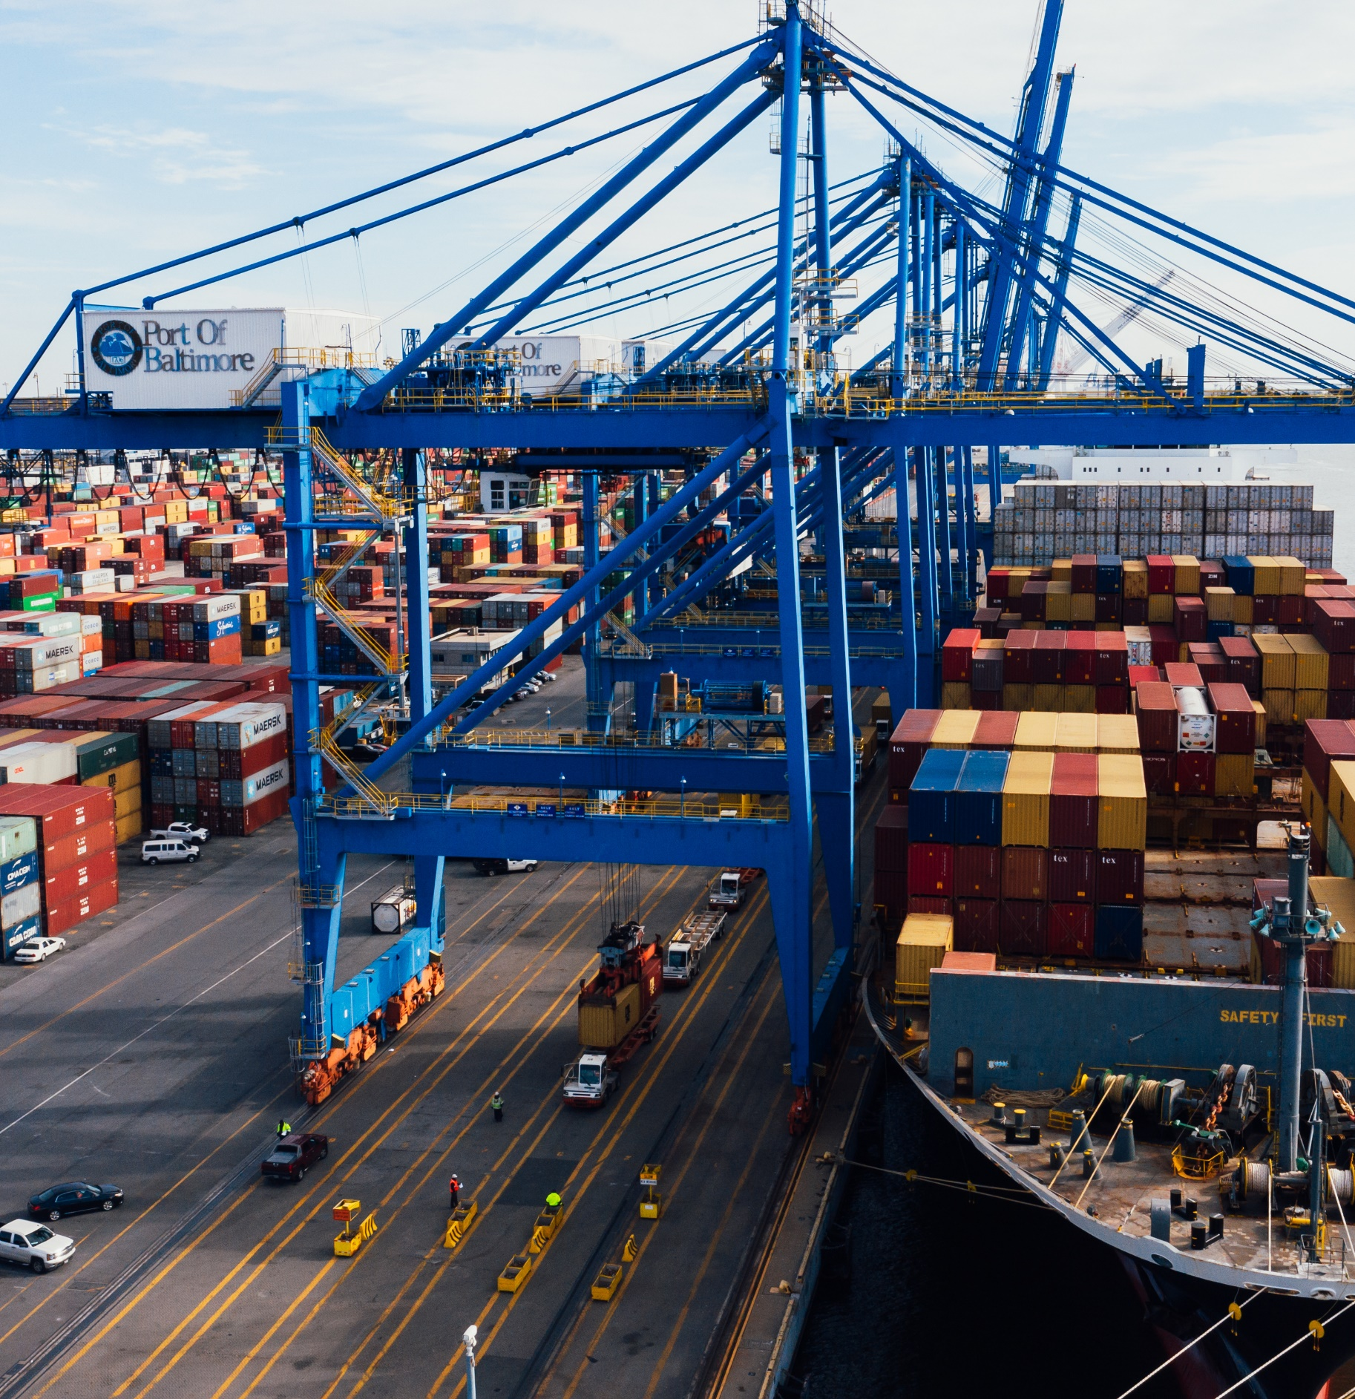
4. The average sales drop during the pandemic was a severe 60.16%, highlighting a major failure in sales channel resilience.
Develop a robust Crisis Response Plan (BCP) to mitigate severe sales drops during external disruptions. The plan must focus on strengthening non-physical sales channels (e-commerce and delivery services) to ensure demand is captured even when in-store shopping is constrained.

Slide 11

5. The business experiences a sharp, across-the-board sales decline in January following holidays, along with historically weak performance in months like April and May.
Implement agile and proactive promotional strategies. Launch robust campaigns early in the year (January) to counteract the sharp post-holiday sales decline. Furthermore, adopt weather-based targeting to capitalize on different conditions (e.g., promoting delivery during bad weather) to stabilize sales during historically weak months.

Slide 12
Technical
Techniques
1.
Data Gathering
2.
Data Preparation and Star Schema Generation
3.
Fact_Demand Data Cleaning
4.
Conclusion and Export
5.
Data Visualization

Slide 13
Data Gathering
We started looking into trusted websites about interesting “Supply Chain” datasets and we landed on this project from Kaggle that analyzes “Retail Stores Inventory and Demand” from 2022 to 2024.

Slide 14
Data Preparation &
Star Schema Generation
The core of this phase was transforming the single, unnormalized CSV file into a flexible Star Schema suitable for dimensional analysis. This involved extracting unique categorical attributes to create five dedicated dimension tables (Dim_Store, Dim_Product, Dim_Date, etc.), each receiving a Surrogate Key. A central Fact_Demand table was then constructed by integrating the original measures with the five new Foreign Keys, linking operational metrics like Units_Sold and Price to their descriptive dimensions.

Slide 15
Fact_Demand Data Cleaning
Cleaning procedures were accurately applied to the 243,200 records in the structured Fact_Demand table. Data types for foreign keys were optimized to Categorical for improved memory management. Critically, 61.485% of missing values in the Units_Ordered column were imputed using the Median value to ensure a robust estimate. Outliers (negative prices) were corrected using the absolute value function, and final checks confirmed zero duplicate rows and no logical inconsistencies between Units_Sold and Inventory_Level.

Slide 16
Conclusion
& Export
Following the accurate dimensional modeling and detailed cleaning process, the Fact_Demand dataset is now fully prepared for advanced analytical tasks. All data types have been optimized, missing values have been robustly imputed, outliers have been corrected based on business rules, and the final dataset is free of duplicates and logical inconsistencies.
The final, clean fact table was exported to the file 'Fact_Demand_Cleaned.csv'.

Slide 17
Data Visualization
Advanced visualization was utilized across four dashboards focusing on Finance, Inventory, Pricing, and External Factors. Key findings included a critical gap in the Fulfillment Rate (Units Sold vs. Units Ordered) and a strong linear relationship between Ordered Units and Demand. The analysis highlighted cross-price elasticity due to alignment with competitor pricing. Furthermore, the Pearson Correlation of 0.00 between the Pandemic Flag and overall Demand suggested a non-linear crisis impact related to distribution channels, not a total demand collapse.

Slide 18
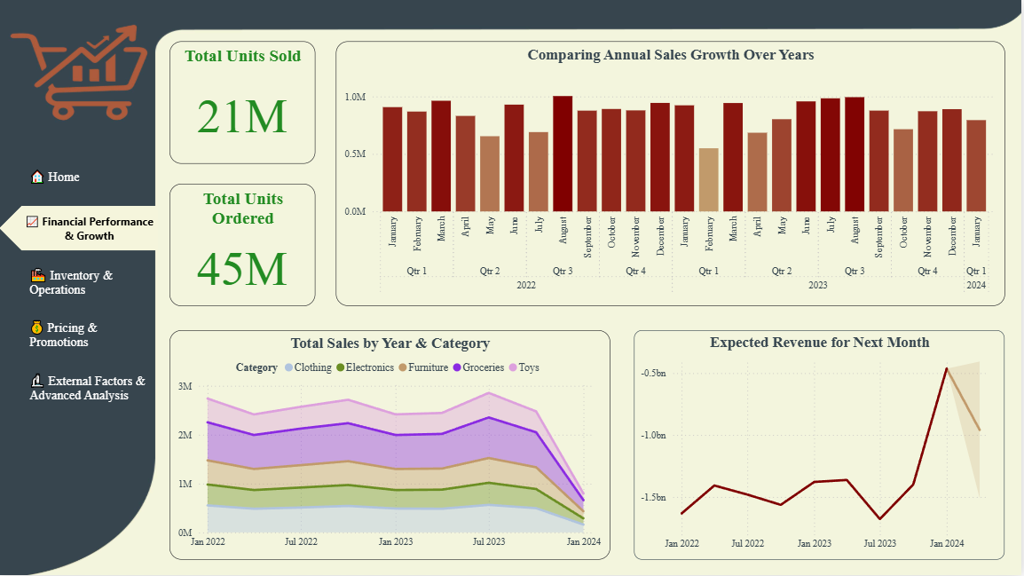
Dashboard 1

Slide 19
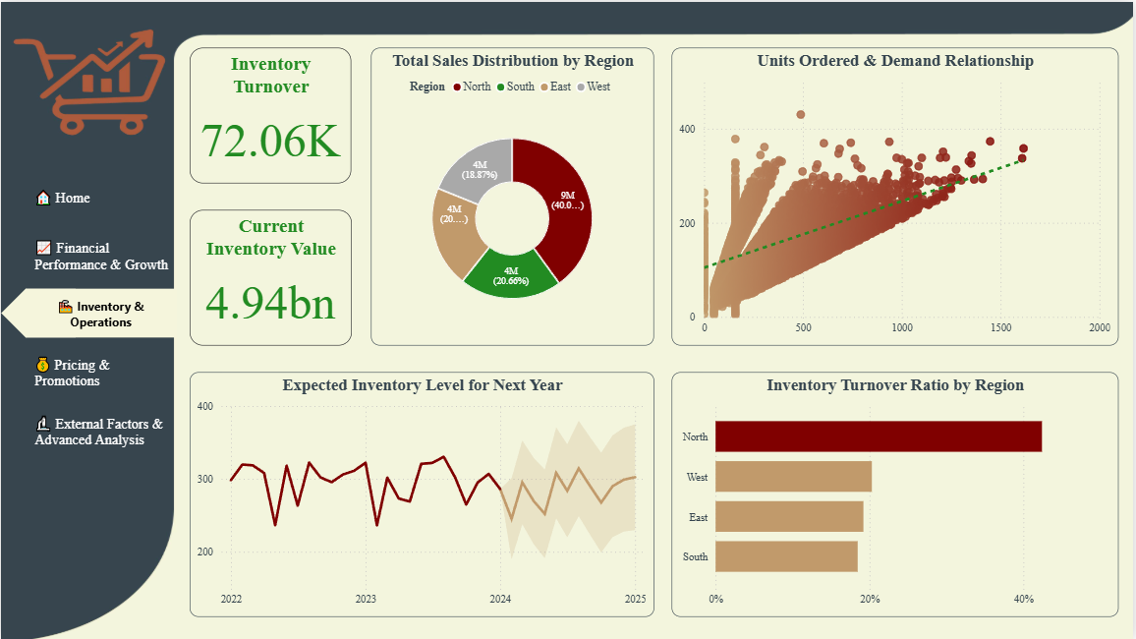
Dashboard 2

Slide 20
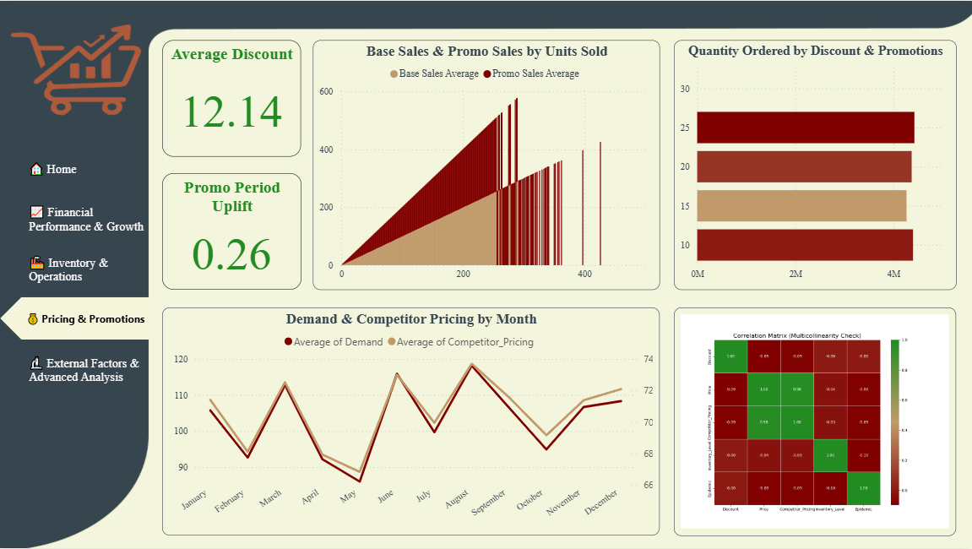
Dashboard 3

Slide 21
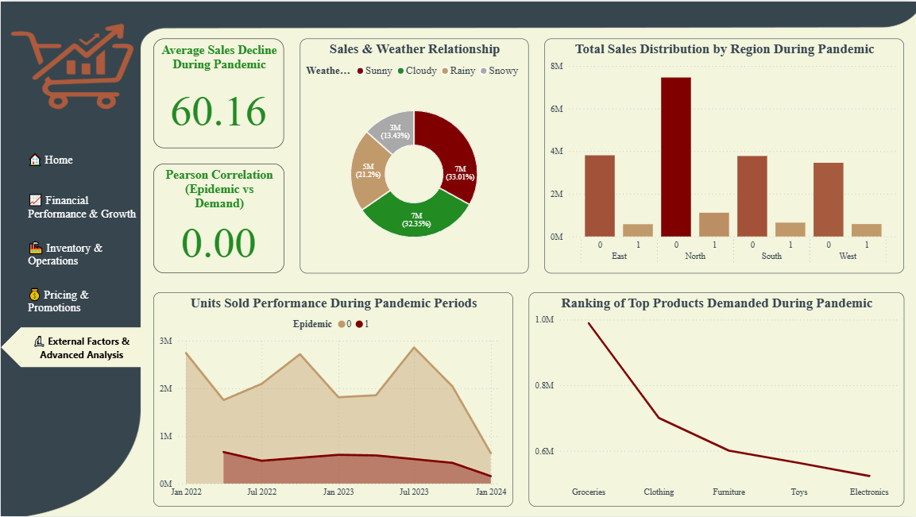
Dashboard 4

Slide 22
Conclusion
There is a severe demand-fulfillment gap and unbalanced regional operations requiring immediate model standardization. To ensure resilience, the company must develop a crisis plan for non-physical channels, prioritizing service quality over transaction size to boost loyalty. Addressing these challenges, alongside seasonal sales drops, is key to achieving stability and sustainable growth.

Slide 23

THANK YOU

